Slide 1

Global Coffee Value Chain Sustainability
From farm to cup, the coffee industry faces mounting pressure to address climate risks, protect farmer livelihoods, and meet evolving consumer expectations. This presentation maps the complete value chain—examining economic realities at origin, quantifying environmental impacts, and identifying high-ROI interventions that deliver both sustainability outcomes and business value. As markets demand transparency and regulators tighten standards, proactive decarbonization and traceability are no longer optional—they're competitive imperatives.

Slide 2
Agenda
01
02
Origin Regions Map
Farm Economics
Global production landscape and the Bean Belt
Cost structures and yield realities for smallholders
03
04
Climate Risk Hotspots
Processing & Logistics Flow
Temperature, water, and pest pressures by region
Mass balance from cherry to consumer
05
06
Certification Landscape
Retail Margin Waterfall
Standards, traceability, and market coverage
Value capture across the supply chain
07
08
Consumer Trendlines
Life Cycle Assessment
Specialty, RTD, and eco-label adoption
Carbon footprint from farm to cup
09
10
Interventions & ROI
Implementation Roadmap
High-impact practices with payback analysis
Phased rollout and stakeholder engagement

Slide 3
Origin Regions: The Global Bean Belt
Coffee production is concentrated within the tropics—roughly 25°N to 25°S latitude—in a band known as the Bean Belt. Smallholder farmers cultivate the majority of the world's arabica, while larger estates and cooperatives dominate robusta output. Understanding this geographic distribution is critical for sourcing strategy, risk management, and targeted sustainability programs.
Brazil
Vietnam
37% of global production
17% of global production
Arabica-dominant; mechanized estates and smallholders across Minas Gerais, São Paulo, and Espírito Santo
Robusta-dominant; Central Highlands concentration with intensive cultivation practices
Colombia
Indonesia
8% of global production
7% of global production
High-quality arabica from mountain slopes; strong cooperative infrastructure and brand reputation
Mixed robusta and arabica; diverse microclimates across Sumatra, Java, and Sulawesi
Ethiopia
Others (50+ origins)
4% of global production—pure arabica from the birthplace of coffee, with unmatched genetic diversity and traditional forest systems
27% combined—includes Central America, East Africa, India, and emerging origins with diverse bean profiles
Production shares vary annually based on weather, market cycles, and policy changes. Buyers increasingly seek origin diversification to manage supply risk and access unique flavor profiles.

Slide 4
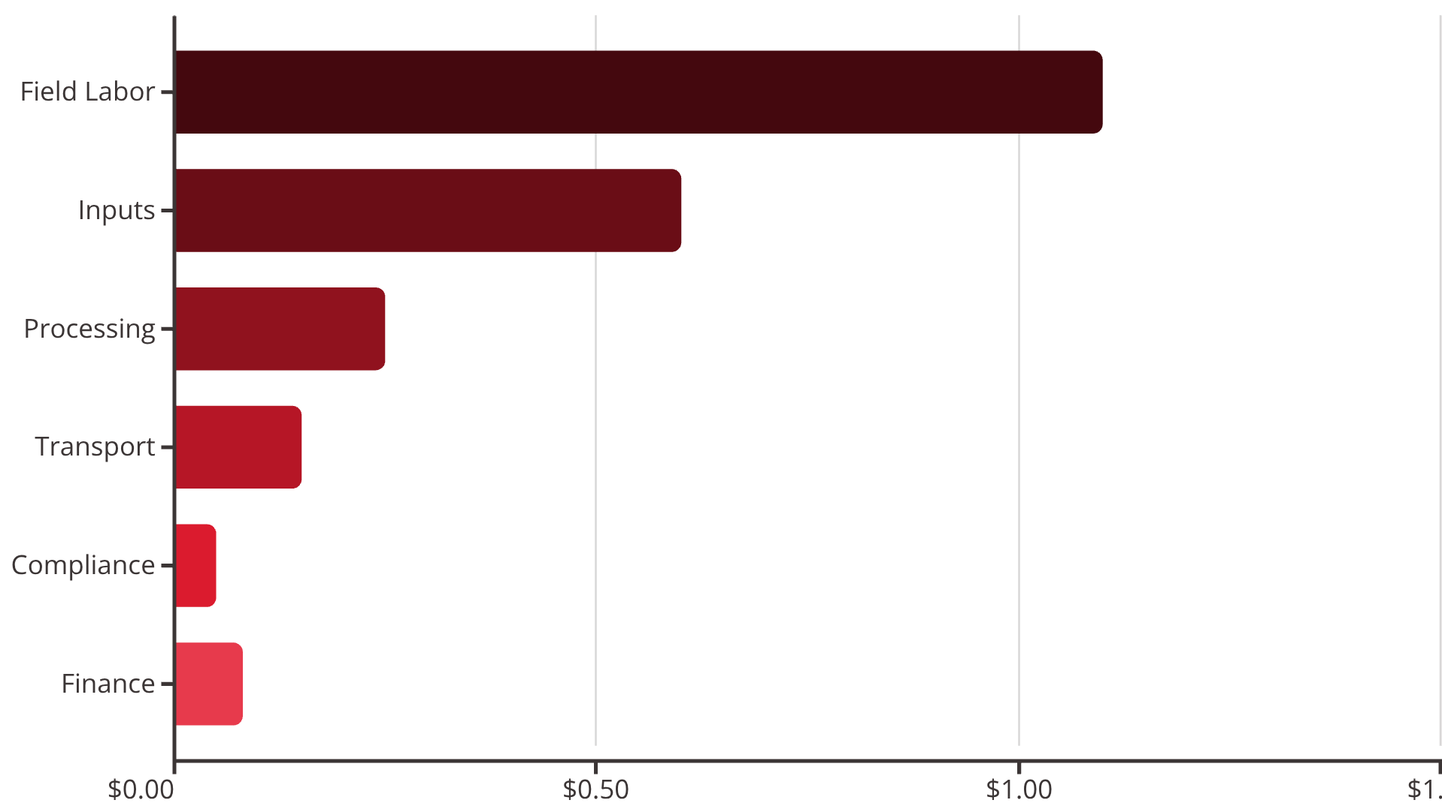

Farm Economics: The Smallholder Reality
For a typical rainfed, mid-altitude arabica smallholder, margins are razor-thin. The economics below represent a 1-hectare operation with approximately 1,600 trees yielding 700 kg of green coffee annually. With farmgate prices around $2.50/kg, gross margins hover near $0.27/kg—leaving little buffer for price volatility, input cost increases, or climate shocks.
Cost Breakdown per kg Green Coffee
Field labor: Pruning, weeding, harvest picking—$1.10/kg
Inputs: Fertilizer, pest management—$0.60/kg
Processing: Wet/dry milling, parchment loss—$0.25/kg
Transport: Farm to collection point—$0.15/kg
Compliance & admin: Co-op fees, documentation—$0.05/kg
Finance: Working capital interest—$0.08/kg
$2.50
$2.23
$0.27
$189
Farmgate Price
Total Cost
Gross Margin
Annual Margin
Average USD per kg green
Per kg to deliver green coffee
Per kg—just 11% of price
Per hectare after costs
These figures are illustrative and vary widely by altitude, farm size, input prices, and certification participation. Climate events, price crashes, or delayed payments can quickly erase margins, pushing farmers into debt or forcing them to abandon coffee cultivation.

Slide 5
Climate Risk Hotspots: Shifting Suitability Zones
Rising temperatures, erratic rainfall, and intensifying pest pressures are reshaping coffee's geographic viability. Studies suggest suitable growing zones will migrate upslope by approximately 300 meters for every 1°C of warming. Regions that thrived for generations now face rust outbreaks, water stress, and heat-induced quality loss. By 2050, many traditional origins may no longer support economically viable production without significant adaptation investments.
Central America (1,000–1,600 m)
Ethiopia Highlands
High risk: Coffee leaf rust resurgence driven by temperature and humidity changes; prolonged droughts reduce yields; suitability loss projected across Honduras, Guatemala, and Nicaragua by mid-century
High risk: Arabica's genetic homeland faces upslope migration pressures; suitable area may shrink 50%+ by 2050; threatens biodiversity and traditional forest coffee systems
Brazil (Minas Gerais)
Vietnam Central Highlands
Moderate-High risk: Heat waves and irregular rainfall patterns; irrigation demand rising sharply; frost risk declining but replaced by heat stress during flowering
Moderate-High risk: Water scarcity intensifying; robusta's heat tolerance being tested; groundwater depletion and reservoir competition with other crops
Suitability by Altitude: 2020–2050 Projection
Key Risk Drivers
As temperatures rise, optimal growing zones shift to higher elevations. Farms at lower altitudes experience declining yields and quality, while high-altitude land becomes newly viable—often requiring deforestation or competing with conservation areas. The chart illustrates projected suitability scores under a moderate emissions scenario (SSP2-4.5).
Temperature increase shifting ideal altitude bands
Rainfall variability and multi-year droughts
Pest and disease pressure (rust, berry borer)
Soil degradation from extreme weather events

Slide 6

Processing & Logistics: Mass Flow from Farm to Cup
Coffee undergoes dramatic mass loss as it moves through the value chain. Starting with 100 units of fresh cherries at the farm, only 16 units reach consumers as roasted, packaged coffee. Wet milling removes pulp and mucilage (60% loss), drying and hulling reduce parchment to green beans, and roasting drives off moisture. Each stage consumes energy and generates waste—pinpointing opportunities for efficiency gains and emissions reductions.
Farm: 100 units
Wet Mill: 40 units
Fresh cherries harvested and delivered to wet mill
Pulping removes 60% mass; parchment coffee emerges
Drying: 22 units
Dry Mill: 20 units
Sun or mechanical drying reduces moisture to ~11%
Hulling removes parchment; green coffee ready for export
Export & Freight
Packaging & Distribution
Green coffee shipped in containers; ~1% shrinkage from spillage and moisture loss during ocean transit
Roasted beans or ground coffee bagged; additional QC removes defects; retail-ready at 16.5 units
1
2
3
4
Roasting
Consumer Purchase
High-temperature process drives off ~14% mass; energy-intensive stage with quality control losses
Final 16 units sold; brewing at home is the largest single energy input in the lifecycle
Energy Hotspots: Roasting and consumer brewing dominate energy use. Wet milling offers biogas opportunities from wastewater. Avoiding air freight and optimizing ocean logistics are low-hanging fruit for logistics emissions.

Slide 7

Certification Landscape: Standards and Market Coverage
Voluntary certification schemes provide frameworks for sustainability claims, traceability, and supplier engagement. Each standard emphasizes different priorities—social equity, biodiversity, organic inputs, or baseline good practices. While certified volumes have grown, over half of global coffee remains uncertified or relies on proprietary buyer standards. Understanding scheme requirements and coverage helps buyers align sourcing policies with risk tolerance and brand positioning.
Scheme
Primary Focus
Traceability
Deforestation-Free
Est. Coverage
Uncertified Volumes
Fairtrade
Price floor, premium, worker rights
Batch/lot level
Increasingly required
5–6%
50%+ of global coffee flows without third-party certification, relying instead on buyer audits, origin reputation, or no formal verification
Rainforest Alliance (UTZ merged)
Biodiversity, climate-smart ag
Mass balance or IP
Yes, explicit criteria
20–25%
Organic
No synthetic inputs
Certified chain
Implicit, not universal
7–8%
4C
Baseline good practices
Mass balance
Baseline checks
10–15%
Direct Trade (various)
Relationship, quality premiums
Often strong, non-standardized
Buyer policy dependent
Variable
Price & Premium
Biodiversity & Climate
Fairtrade guarantees floor pricing; Direct Trade often pays higher premiums but lacks standardization
Rainforest Alliance and Organic emphasize ecosystem services; others less prescriptive
Social Standards
Deforestation-Free
Fairtrade leads on labor rights and community investment; 4C sets baseline expectations
Rainforest Alliance and emerging EU regulations drive explicit no-deforestation commitments
Many buyers now blend certifications with proprietary supplier codes that address gaps—such as living income benchmarks, water stewardship, or traceability to GPS coordinates. Schemes continue to evolve in response to market demands and regulatory pressure.

Slide 8
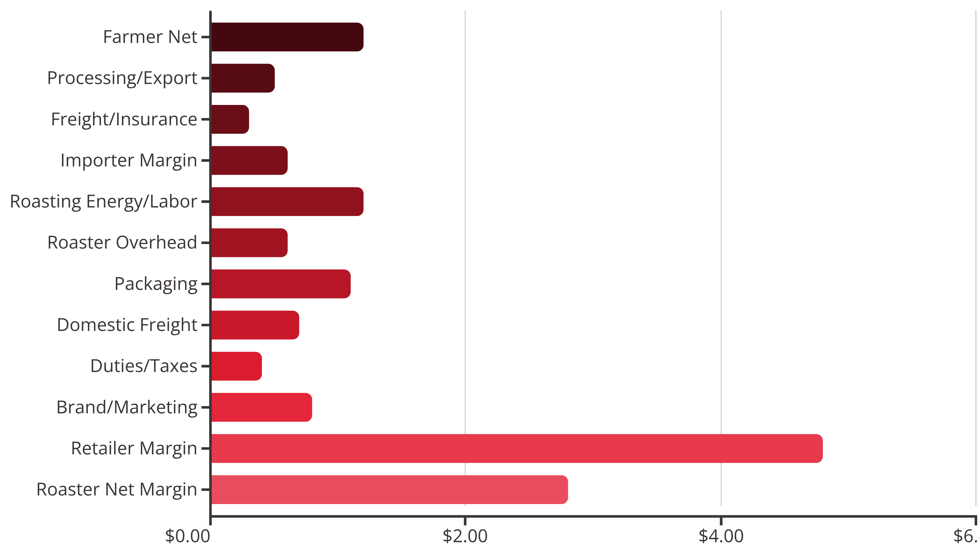

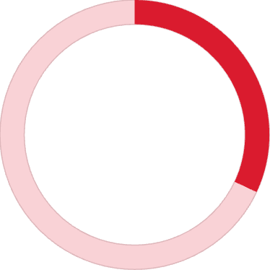

Retail Margin Waterfall: Where Does the $15 Go?
A typical 12-ounce retail bag priced at $15 flows through multiple hands before reaching the consumer. Farmers capture roughly 8% of the retail price—about $1.20 per bag—while retailers and roasters secure the largest margins. Understanding this value distribution is essential for assessing the feasibility of premium payments, sustainability investments, and supply chain financing.
8%
32%
19%
Farmgate Share
Retailer Margin
Roaster Net Margin
Farmer receives ~$1.20 of the $15 retail price
Largest single share at $4.80 per bag
$2.80 after covering roasting, overhead, and packaging
These figures are illustrative and vary significantly by channel (direct-to-consumer vs. grocery), volume scale, origin premiums, and brand positioning. Specialty and DTC models often shift more value toward origin, while mass-market channels compress farmgate share.

Slide 9
Consumer Trendlines: Shifting Preferences and Price Sensitivity
Consumer behavior is evolving rapidly. Specialty coffee's market share continues to climb as quality expectations rise. Ready-to-drink formats are booming, driven by convenience and innovation. Sustainability credentials increasingly influence purchase decisions, with eco-label intent up 12 percentage points since 2018. The pandemic accelerated at-home brewing upgrades—espresso machines, grinders, and pour-over gear—creating new quality benchmarks and willingness to pay premiums for traceable, ethical coffees.
Key Growth Drivers
Price Elasticity Snapshot
Specialty share: +2–3 percentage points over five years, reflecting premiumization and third-wave café expansion
At-home demand elasticity: ≈ -0.6 (relatively inelastic; modest price increases tolerated)
Ready-to-Drink (RTD): 8–10% CAGR globally; cold brew, nitro, and functional blends leading innovation
Out-of-home elasticity: ≈ -1.1 (more elastic; consumers sensitive to café price hikes)
Premium positioning and sustainability messaging can reduce elasticity, especially among younger, urban, and high-income segments.
Eco-label adoption: Purchase intent for certified/sustainable coffee up ~12 pp since 2018; Gen Z and Millennials over-index
Plant-based milks: Double-digit growth in coffee applications; sustainability and health cited as primary drivers
2015–2018
2021–2023
Third-wave cafés proliferate; pour-over and single-origin become mainstream
Sustainability claims become table stakes; traceability and carbon footprint labels emerge
1
2
3
4
2019–2020
2024–2025
RTD cold brew explodes; pandemic shifts consumption home; equipment sales surge
Functional coffees (adaptogens, probiotics) gain traction; direct-trade storytelling scales
Understanding these trends allows roasters, retailers, and origin partners to align product development, marketing, and sourcing investments with where consumer dollars are flowing—and what claims will command premiums.

Slide 10
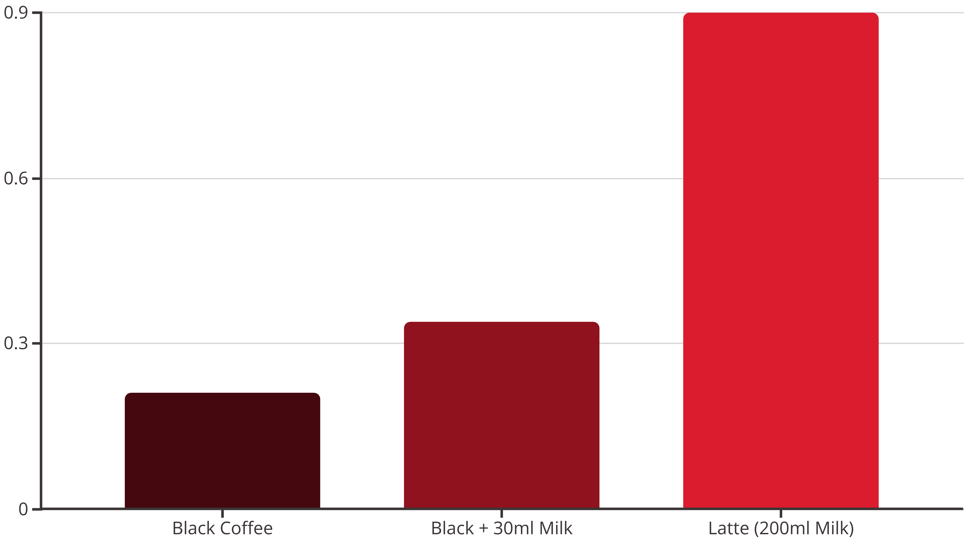
Life Cycle Assessment: Carbon Footprint from Farm to Cup
A full life cycle assessment (LCA) quantifies greenhouse gas emissions from farm inputs through disposal. For a 250 ml cup of black coffee, emissions average about 0.21 kg CO₂e. Add milk, and the footprint jumps dramatically—dairy's impact dwarfs coffee's in milk-heavy beverages like lattes. Consumer brewing energy also looms large, particularly in regions reliant on fossil-fueled grids. Reducing emissions requires interventions across the entire chain, not just at origin.
Farm & Inputs
Consumer Brewing
45% of black coffee footprint—fertilizer production, land management, and N₂O emissions from soils dominate
35% of footprint—electric kettles, drip makers, and espresso machines; varies by energy mix
Roasting
Packaging
6%—natural gas or electric roasters; efficiency upgrades and renewables reduce impact
6%—foil-lined bags, valves, and labels; lightweighting and recyclable materials help
Transport
Retail & Last Mile
5%—ocean freight origin to market; slow steaming and carrier selection matter
3%—warehousing, delivery; relatively minor unless air freight used
Water Footprint Note
Milk's Outsized Role
Coffee's water footprint is dominated by green water (rainfall), with blue water (irrigation) hotspots in Brazil and Vietnam. Efficient processing and wastewater treatment reduce freshwater impact.
Dairy milk contributes 60–75% of a latte's emissions. Shifting to plant-based alternatives (oat, almond) can cut beverage footprint by 50%+ while appealing to sustainability-conscious consumers.
These are indicative factors; actual emissions vary by farming practice (shade vs. sun, organic vs. conventional), grid carbon intensity, brewing method (French press vs. espresso), and serving size. Regular updates and primary data improve accuracy.

Slide 11

Interventions and ROI: High-Impact, Financially Viable Actions
Decarbonization and resilience investments need not sacrifice profitability. Many interventions deliver positive net present value within 3–5 years through yield gains, input savings, or energy cost reductions. The bubble chart below maps abatement potential against payback period, with bubble size indicating capital intensity. Farm-level practices—agroforestry, soil health, precision inputs—often qualify as "no-regrets" moves, improving both climate outcomes and farmer incomes.
Shade Agroforestry
Soil Health Programs
Precision Fertilization
Capex: $350/ha | Payback: 3–4 yrs
Capex: $120/ha/yr | Payback: 1–2 yrs
Capex: $50/ha (training) | Payback: <1 yr
Abatement: 18 tCO₂e/1k bags
Abatement: 9 tCO₂e/1k bags
Abatement: 6 tCO₂e/1k bags
Heat resilience and yield stability
Compost and mulch application
Soil testing and tailored nutrient plans
Biodiversity and soil health co-benefits
Yield increase ~8% via nutrient retention
Input cost savings ~15%
Premium quality from slower cherry maturation
Improved water infiltration and drought tolerance
Reduced N₂O emissions from over-application
Wet Mill Water Recycle + Biogas
Efficient Roasters + Heat Recovery
On-Site Solar (Roastery)
Capex: $7k/co-op | Payback: 2–3 yrs | Abatement: 14 tCO₂e/1k bags
Capex: $70k/plant | Payback: ~3 yrs | Abatement: 22 tCO₂e/1k bags
Capex: $150k | Payback: 4–6 yrs | Abatement: 12 tCO₂e/1k bags
Closed-loop water systems and anaerobic digestion of pulp waste; displaces LPG for drying; eliminates effluent discharge
Modern fluid-bed or loring-style roasters with afterburners and heat exchangers; consistent quality and lower fuel use
Rooftop or carport PV systems; energy cost hedge against grid volatility; pairs well with battery storage
Packaging & Logistics
Deployment Priorities
Lightweight, recyclable packs: +$0.05/bag; immediate payback via freight savings; 2 tCO₂e abatement per 1k bags
Start with high-ROI, low-capex interventions like precision fertilization and soil health. Layer in agroforestry as pre-harvest finance becomes available. Roaster upgrades justify themselves through energy and quality gains. Solar and advanced processing require patient capital but deliver long-term resilience.
Ocean freight optimization: No capex; slow steaming and carrier choice; 5 tCO₂e abatement; cost-neutral or savings
Economics are indicative and must be validated locally. Farmer cooperatives, development finance, and buyer partnerships can de-risk capital outlays. Many practices deliver yield, quality, and resilience co-benefits that extend beyond carbon accounting.

Slide 12
Implementation Roadmap: Phases, Workstreams, and Stakeholder Roles
Transforming the coffee value chain requires coordinated action across farms, cooperatives, exporters, roasters, retailers, financiers, and governments. The roadmap below outlines a phased approach over 36 months, with clear milestones, KPIs, and stakeholder commitments. Success depends on transparency, shared risk, and aligning incentives so that sustainability investments flow to those who bear the costs—especially smallholder farmers.
0–6 Months: Baseline & Pilots
18–36 Months: Verification & Expansion
Complete origin mapping and farm economics survey
Achieve 90% traceable volumes with GPS verification
Conduct GHG and water footprint inventory
Validate deforestation-free compliance via third-party audit
Launch supplier code and NDPE due diligence
Ocean freight decarbonization commitments (slow steaming, low-carbon carriers)
Pilot shade/soil programs in 2 cooperatives
Implement supplier performance-linked premium payments
Roast energy audit and efficiency baseline
Publish annual progress report with transparent data
1
2
3
6–18 Months: Scale & Infrastructure
Scale agroforestry and soil health to 30% of volume
Finance via pre-harvest loans and DFI partnerships
Install wet mill water recirculation/biogas in 3 hubs
Upgrade roasters with heat recovery systems
Secure renewable energy PPAs for roasting facilities
Switch packaging to lightweight recyclable across SKUs
Workstreams and Ownership
Farming & Resilience
Traceability & Compliance
Roasting & Energy
Owner: Sourcing + NGO partners
Owner: Sustainability + Procurement
Owner: Operations/Engineering
KPIs: Yield +10%, shade coverage (ha), farmer income
KPIs: % lots GPS-traced, deforestation risk cleared
KPIs: kWh/kg roasted, Scope 1–2 reduction %
Logistics & Packaging
Consumer & Brand
Owner: Supply Chain
Owner: Marketing
KPIs: g CO₂e/kg-km, recycled content %, lightweighting %
KPIs: Eco-label adoption %, consumer education reach
Stakeholder Commitments
Farmers/Cooperatives: Adopt shade/soil/IPM practices; share plot data for monitoring, reporting, and verification (MRV); receive premiums and input support
Certifiers/NGOs: Streamline audit processes; align metrics across schemes; provide training and extension support at origin
Exporters/Importers: Provide traceability documentation; offer pre-financing and working capital; segregate certified and origin-verified lots
Financiers/DFIs: Offer concessional credit, risk-sharing facilities, and blended finance for smallholder climate adaptation
Governments: Enforce land-use regulations; provide climate-smart extension services; invest in water stewardship infrastructure
Roasters: Invest in energy-efficient equipment; shift to renewable energy; publish sustainability specifications to suppliers
Retailers: Commit to shelf standards for certified/traceable coffee; co-fund certification fees; enable transparent pricing to consumers
Implementation success hinges on coordinated investment, transparent data sharing, and equitable value distribution. The roadmap is a living document—adjust timelines and priorities based on pilot learnings, market conditions, and emerging regulations. Regular stakeholder convenings ensure alignment and accountability.

